Slide 1


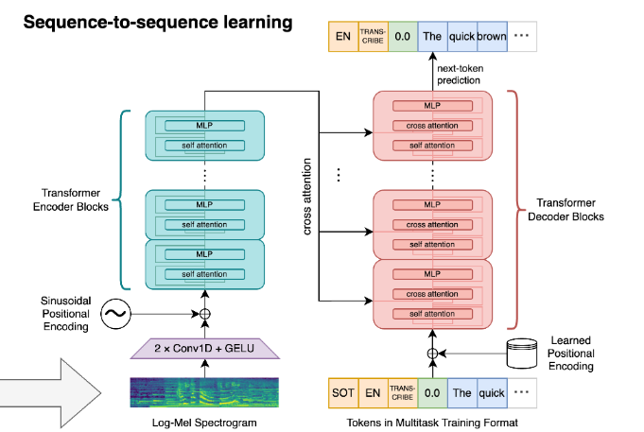
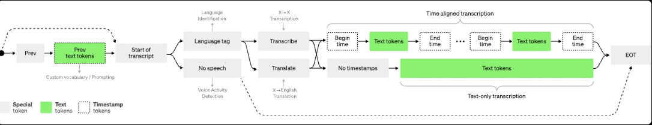
SpeCor: Speech Recognition and Stutter Correction
By: Abdelrahman Fakhry Hussein, Mohamed Abdelmonem Abdelrahman, Mohammed Mahmoud Hasan,
Tarek Abo Elenen Ali, Basma Ahmed Said, Eman Basem Ezzat
Supervised by: Dr. Manal Tantawi, T.A. Manar Sultan
Faculty of Computer and Information Sciences - Ain Shams University
Introduction
Results
Voice-based communication often falls short for individuals with speech impediments such as stuttering and lisping. These speech patterns can lead to significant inaccuracies in transcription, causing frustration and limiting the usability of ASR systems for these users. Current Automatic Speech Recognition (ASR) systems are designed to handle typical speech patterns, making them inadequate for accurately transcribing speech from individuals with stuttering and lisping.
Develop a robust system that effectively converts spoken input into accurate transcription text and enhances the accessibility and inclusivity of ASR technology by providing accurate transcriptions for individuals with speech impediments.
The evaluation of ASR systems was conducted using Word Error Rate (WER) on two datasets: LibriSpeech and LibriStutter. These datasets were used to train and test the models, providing insights into their performance with both non-stuttered and stuttered speech.
Train Test | LibriSpeech | LibriStutter
Using LibriSpeech Only | 8.3 | 95.5
Using LibriStutter Only | 445.39 | 212.05
Using LibriSpeech & LibriStutter | 9.24 | 16
Methods
The Table Showing Results Using WER Against LibriSpeech and LibriStutter
By combining both datasets and fine-tuning the hyperparameters during training, the model achieved a balance in accuracy for both stuttered and non-stuttered. Although the accuracy decreased for the LibriSpeech dataset, this trade-off resulted in improved performance for stuttered speech. The combined training approach provides a more inclusive ASR system capable of handling a wider range of speech patterns.
Conclusions
SpeCor, addresses critical challenges in ASR, specifically the accurate transcription of speech impediments. This is essential for making ASR technology more inclusive and reliable.
Speech impediments significantly distort the acoustic features of speech, confusing ASR systems and reducing transcription accuracy.
SpeCor is designed to address these limitations by incorporating mechanisms to correct stuttering and lisping, enhancing the accuracy of speech recognition. The system integrates advanced deep learning algorithms trained on diverse datasets, enabling it to recognize and correct errors associated with speech impediments and accents.
The architecture is a simple end-to-end approach, implemented as an encoder-decoder Transformer.
1 - Adding noise to data so that the model could train on noisy data.
2 - Input audio is split into 30-second chunks and converted into a log-mel spectrogram.
3 - Converting text into tokens, the tokenizer enables the model to handle language in a structured manner. This process is essential for various NLP tasks, including speech-to-text conversion
4 - It is passed into an encoder.
5 - A decoder is trained to predict the corresponding speech transcription.
6 - Beam search explores multiple possible transcriptions simultaneously and selects the best one based on a scoring function.
7 - Adding punctuation marks to the raw transcription to improve readability.
8 - Applying additional language models or rules to correct common transcription errors and improve overall accuracy.
Bibliography
1- A. Radford, J. W. Kim, T. Xu, G. Brockman, C. McLeavey, and I. Sutskever, “Robust Speech Recognition via Large-Scale Weak Supervision,” arXiv:2212.04356 [cs, eess], Dec. 2022.
2- V. Panayotov, G. Chen, D. Povey, and S. Khudanpur, “Librispeech: An ASR corpus based on public domain audio books,” 2015 IEEE International Conference on Acoustics, Speech and Signal Processing (ICASSP), Apr. 2015.
3- T. Kourkounakis, A. Hajavi and A. Etemad, "FluentNet: End-to-End Detection of Stuttered Speech Disfluencies With Deep Learning," in IEEE/ACM Transactions on Audio, Speech, and Language Processing, vol. 29, pp. 2986-2999, 2021.
4- A. Mohamed, D. Okhonko, and L. Zettlemoyer, “Transformers with convolutional context for ASR,” arXiv (Cornell University), Jan. 2019.
Model Process
Order online at https://www.postersession.com/order/

